Slide 1
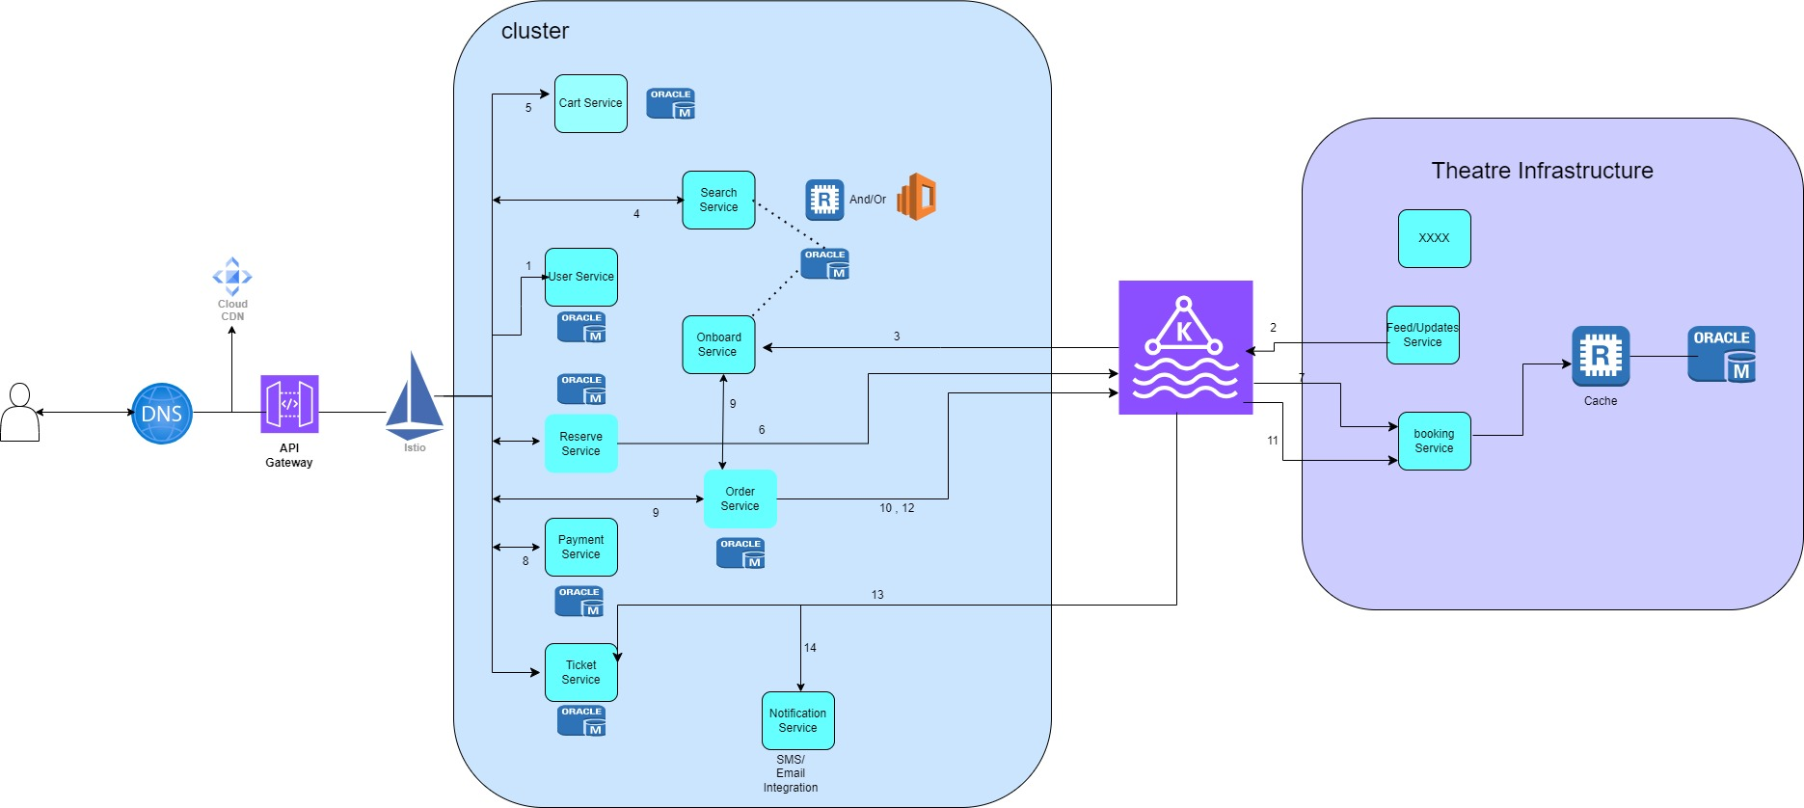
Architecture Diagram

Slide 2
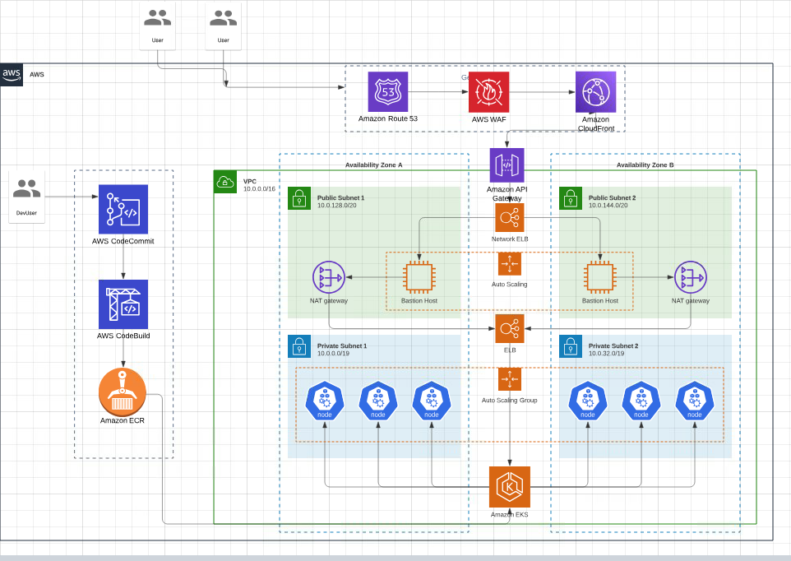
Architecture Diagram

Slide 3
Transactional Scenarios and Decisions
How does Platform coordinate to Theatres Server and get Seat Availability Information?
Our Platform can work along with the theatre to keep updating the seat availability information. Then the ticket will be offered to the users.
Theatre has allocated specific seats inventory which can be booked by platform users
Theatres would be onboarded to platform by sending updates or onboarding events via messaging system
Platform will receive events in case seats are reserved/booked by our platform or by theater itself or by some other platforms integrated with that theatre
The theatre’s server needs to follow a timeout locking mechanism strategy where a seat will be locked temporarily for a user for a specific time session (for example, 5-10 minutes). If the user is not able to book the seat within that timeframe then release the seat for another user. This should be done on a first come first serve basis.
Platform will invoke Theater Server API or send a message using messaging system to reserve/ book a ticket . As the IO requests are high, depend on blocking call timings, can go for Async calls.
If theater/ or other platform, books /reserves any seat from their own system, our platform will receive event updates as that our platform can make the seat unavailable.

Slide 4
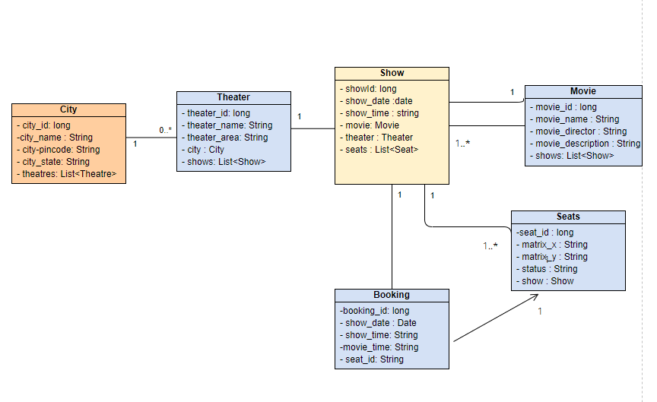
Data Modelling

Slide 5
Monetize Platform
Offers during the payment will increase customer base and service charges applied will increase based on tickets booked.
Advertisements over the platform can help in revenue.
Offers in snacks booking along with Ticket can help again by taking commission from Theater vendors.
Scaling Platform
Autoscaling enabled for pods to handle peak requests
Multiple Web Servers load balanced
Master Slave RDMS in different availability Zones . Read Replicas maintained for faster response
Redis Caching to hold the DB information for cities/theater/shows to reduce backend traffic to DB
Aysnc process rest calls to Theater API’s
DR can be placed in other region for Disaster recovery
CDN and Webserver caching for static content e.g videos, trailers, images
Release management Across Cities
Separate Config project for various environments and various regions and controlled by Spring profiles
I18 internalization applied for Messages for various languages supported on UI
Code Pipelines with actions , to deploy to various regions
CDN for static content
Canary Deployment/Blue Green Deployment Methodology can be used to keep 99.99% availability during the releases
Monitoring
Cloud Watch Events in AWS generated for servers . Using Alarms,Alerts and CloudTrail , can help in additional monitoring
Prometheus and Grafana can helping in configuring alerts and log aggregation.
AWS distributed tracing Xray can be integrated

Slide 6
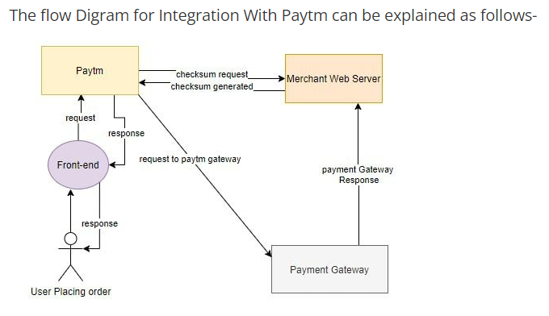
Integration with Payment gateway - PAYTM
Get the API keys from Paytm dashboard and properties to configure in application properties.
Add the paytm dependency Jar to pom.xml
Set the controller methods to send the payment request using the checksum and /pgresponse controller mapping method and validate the checksum again.

Slide 7
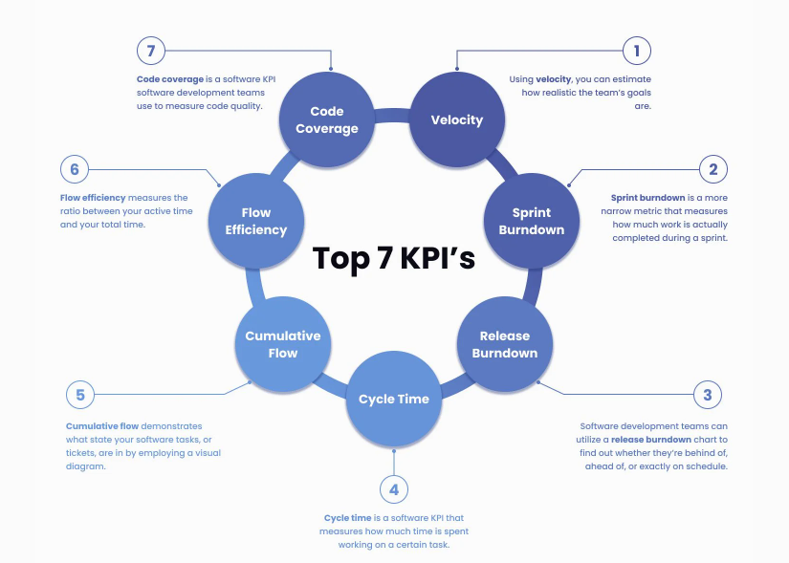

Slide 8
Top 10 OSWAP Securities
Broken Access Control
CloudTrail Integration With App
Role based Access for the resources/endpoints
Cryptographic Failures
SSL Integration to protect data in transit
Integration with KMS keys for encryption and Secrets Manager for confidential information – protecting data at rest
Injection
SQL Injection – use parameterized Queries
Implement Command Query Responsibility Segregation (CQRS)
Insecure Design
All Access controls in place across the network e.g security groups etc
Oauth 2 implementation
Security Misconfiguration
No logging with confidential information
Configurations validation before deployment, more usage of templates for various environments for deployment
Vulnerable and Outdated Components
Code Scanning – snyk vulnerability checks in place from pipelines
Penetration testing implemented by QA or organisation
Identification and Authentication Failures
Multifactor Authentication and Identity/Authentication provider token based Authentication (OAuth2)
Usage of Presigned Urls or temporary crendentials with TTL
Software and Data Integrity Failures
Third party jars used are not vulnerable and use trusted repositories
Proper Access control in place when using CI/CD or while distribution of data to clients
Security Logging and Monitoring Failures
Cloutrail/Cloud Watch integration and Dashboard to display and do analysis of logs. Security Groups are reviewed as per limited usage
No PI information in logs and even in DB . Severs and DB having replication and fault tolerant .
Server-Side Request Forgery
White listing of input
Limited ip address / ports open . Inbound /Outbound Traffic controlled properly and reviewed

